Slide 1
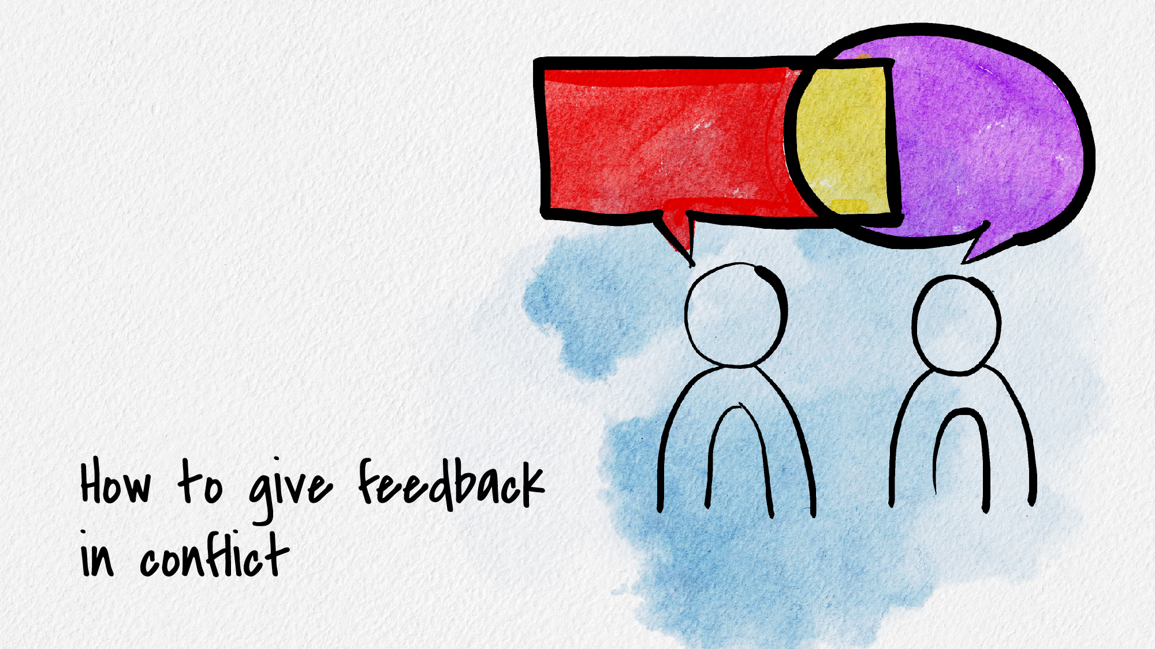

Slide 2

Understand Your Own Conflict Style
When emotions are high, we often have go-to patterns in how we deal with them. Do you tend to fight, flight, or freeze?
How good are you at giving and receiving feedback?
Develop ways of grounding yourself in conflict so that you don’t just
default to your conflict style
  Breathing long, slow, and deep through the stomach
  Feeling soles of the feet on the ground
  Taking a break
  Engaging in self-care before (ex: walk, art, journaling, talking to someone outside the conflict)

Slide 3
The COIN Model for Feedback
Compare:
  Establish with the other person that you want to collaborate
Observations
  Work with them to figure out objective observations about the situation
Impact
  Discuss the impact the situation had on you and others
Next Steps
  Create a plan together so this doesn’t happen again

Slide 4
Compare (“C” of COIN)
•
Approach this person with the intent to compare your versions of what happened
(instead of with the intent to protect your own way of seeing things)
You probably made some assumptions about what happened, and so did the other person. Your assumptions are probably different from theirs
If you approach the situation by trying to “show” the other person that you’re “right,” a wall
is put up that stops the other person from hearing you
Despite any strong emotions involved, this conversation is about collaboration between two
realities
If at all possible, make sure you are in a good emotional space to talk
If at all possible, make sure the other person has the time and energy to talk
Introduce the idea gently instead of beginning with an accusation:
  For instance: “I wanted to touch base with you to get a sense of what happened with the group project“ or “I’m having a narrative about the group project we just finished and I wanted to check in with you about it”

Slide 5
Observation (“O” of COIN)
•
Move past assumptions, figure out what the facts are
Articulate, step by step, the facts as you know them (with no interpretations)
  Do not use big general statements like “always” or “never.” Come up with concrete
specifics when possible.
  Ex: I checked the signup sheet and you had signed up for X portion of our group
project…
If their version of the facts is different, they will say so and together you can figure out what the objective facts are
Sometimes in this stage, you may realize your “case” for being upset doesn’t make sense now that you are clearer on the facts
Make sure you agree on what happened before you got to the next step of COIN (impact). Do not talk about how it impacted you before you both understand the facts. Again: it’s not about being right!

Slide 6
Impact (“I” of COIN)
Make sure you have finished the Observation stage before moving to Impact
•
Name the effects of the objective facts you agreed on
Ex: “Maria and I stayed up very late working on the portion of the group project that you had signed up for. It’s shaken my trust in you as a group member”
Stay in the conversation until you see they feel the impact (this is different than guilt-tripping them). You may just see the impact on their face, the moment they realize they caused you distress and it was unfair to you

Slide 7
Next Steps (“N” of COIN)
Again: completely separate the step of processing the situation from the step of problem-solving
The better Compare, Observations, and Impact went, the smoother Next Steps will go
•
Work together to decide how to avoid this problem arising in the future
Give the person you’re giving feedback to the chance to come up with their own next steps so that you really have their buy-in and they’ve come up with a plan that they have the ability and desire to follow through with
This step is uncomfortable. Don’t rush through it
Be honest about whether the plan they come up with meets your needs and make sure the plan feels good to them, too.
Plan should be specific, concrete, actionable, and time-bound
  “So it sounds like you’re committing to emailing the group every Friday about how you’ve progressed with your portion of the next group project”

Slide 8
Key takeaways about conflict
If you forget COIN, at least remember these two things:
  When emotions are high, our perspective of the world narrows. We often feel that our own emotions are “right.” Ground yourself and aim to collaborate with the other person instead
  Process the situation with the person first. When you are done processing it with them, problem-solve. Do not mix these two together

Slide 9
How do I try this out?
The more intense or longstanding the conflict is, the more challenging COIN will be to implement
As a COIN beginner, start with easier conflicts (2/10 challenge level) to get practice and work your way up to higher challenge levels
If you and someone else both learn COIN, it becomes even easier to implement together

Slide 10
Thank you!
If you’d like to connect with Counseling and Psychological Services (CAPS), we’re here for
you.
Individual Counseling
Call to schedule an appointment: (402) 472-7450
Let’s Talk
Chat informally with a professional from CAPS. Learn more at https://caps.unl.edu/lets-talk
Virtual sessions are available by appointment.
In-person sessions available through TRIO or Military & Veteran Success Center
Counseling and Psychological Services | Located in the University Health Center, Level Two

