Slide 1
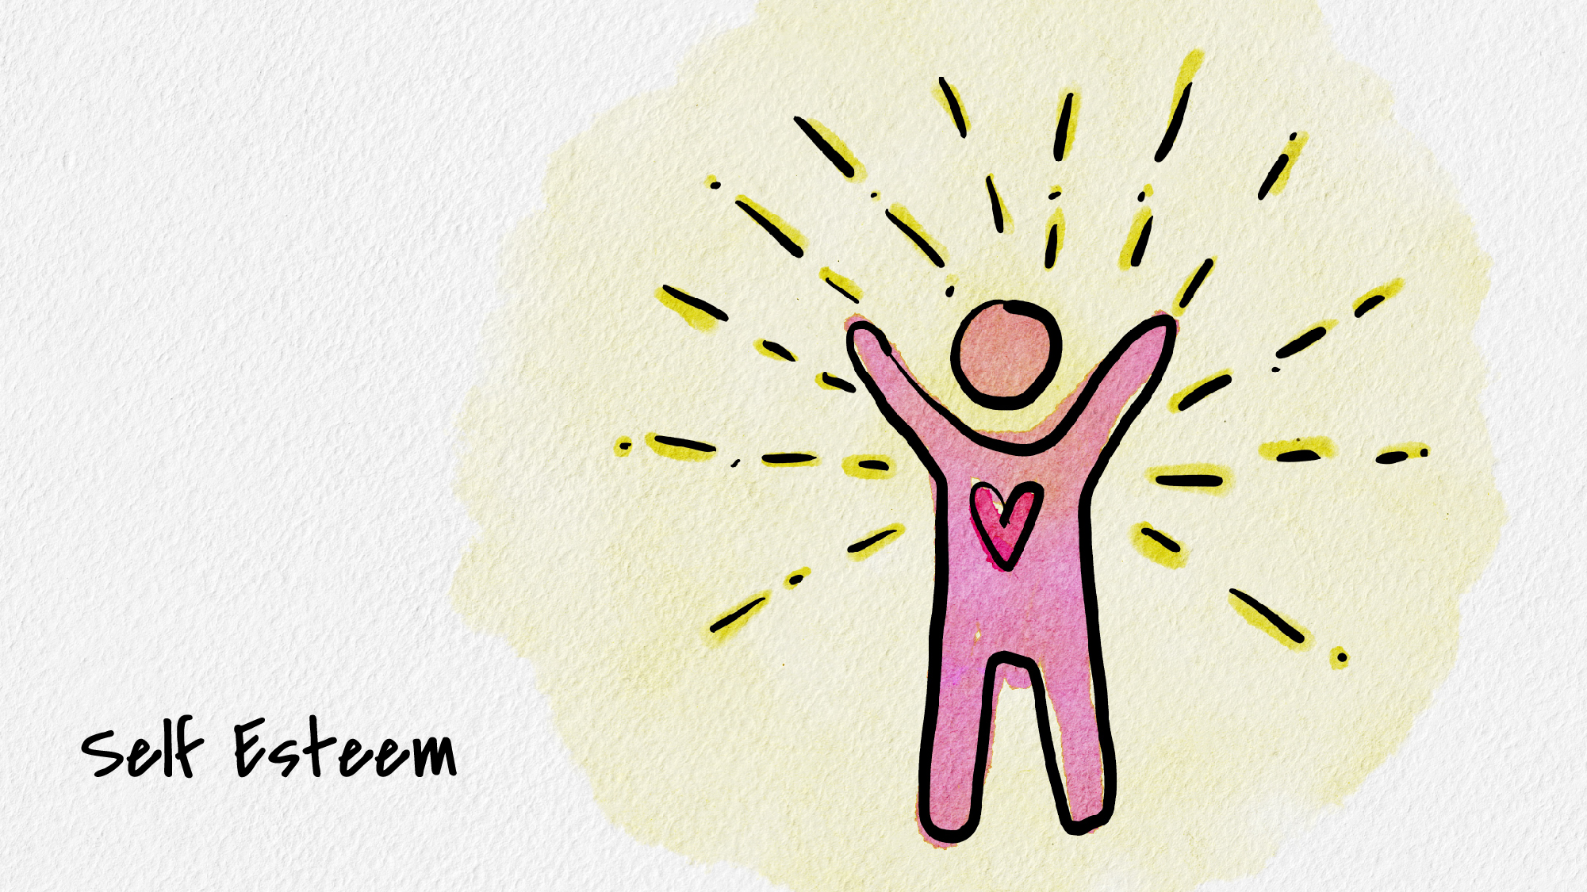


Slide 2
“When we plant a rose seed in the earth, we notice that it is small, but we do not criticize it as “rootless and stemless.” We treat it as a seed, giving it water and nourishment required of a seed. When it first shoots up out of the earth, we don’t condemn it as immature and underdeveloped, nor do we criticize the buds for not being open when they appear. We stand in wonder at the process taking place and give the plant the care it needs at each stage of its development. The rose is a rose from the time it is a seed to the time it dies. Within it, at all times, it contains its whole potential. It seems to be constantly in the process of change; yet at each state, at each moment, it is as it is” (Gallwey, 1974).

Slide 3
Self esteem: A realistic, appreciative opinion of oneself
Consequences of low self-esteem
Depression
Anxiety
Psychosomatic illness (headaches, fatigue, GI problems)
Hostility, excessive/deep-seated anger, dislike & distrust of others, competitiveness
Alcohol/drug abuse
Interpersonal problems (unhealthy relationships, withdrawal, loneliness)
Poor communication
Shame
Sensitivity to criticism
Tendency to put on a false front to impress others
Poor performance/classroom achievement
Preoccupation with problems
Status concern
Consequences of high self-esteem
Increased self-confidence
Increased self-efficacy
Less negative self-talk
Healthy communication and boundaries in relationships

Slide 4
How do we increase self-esteem?
Increase unconditional self-worth
  Disentangle worth from externals
  Distinguish between shame and guilt
  Practice positive self-talk
    E.g. “Even though I said something stupid in class, I’m still an important and valuable person.”
  Recognized the things you are doing well and celebrate your accomplishments
  Recognize automatic thoughts and distortions

Slide 5
Automatic thoughts and distortions
Assuming
Shoulds
All or nothing thinking
Overgeneralizing
Labeling
Dwelling on the negative
Rejecting the positive
Unfavorable comparisons
Catastrophizing
Personalizing
Blaming
Making feelings into facts

Slide 6
How do we increase self-esteem?
Increase self-love and self-compassion
  Connect with others
  Acknowledge an accept positive qualities
  Avoid because, therefore statements
    E.g. “Because I failed, I’m therefore stupid.”
  Talk to yourself like you would talk to a friend

Slide 7
Take away points
Critical voice is just one voice among many
  Learn to embrace/empower your self-compassionate voice
  Turn down the negative noise
Recognize the things that you are doing well
Rewarding yourself and being kind to yourself are other ways to be productive

Slide 8
Thank you!
If you’d like to connect with Counseling and Psychological Services (CAPS), we’re here for you.
Individual Counseling
Call to schedule an appointment: (402) 472-7450
Let’s Talk
Chat informally with a professional from CAPS. Learn more at https://caps.unl.edu/lets-talk
Virtual sessions are available by appointment.
In-person sessions available through TRIO or Military & Veteran Success Center.
Counseling and Psychological Services | Located in the University Health Center, Level Two

