Slide 1
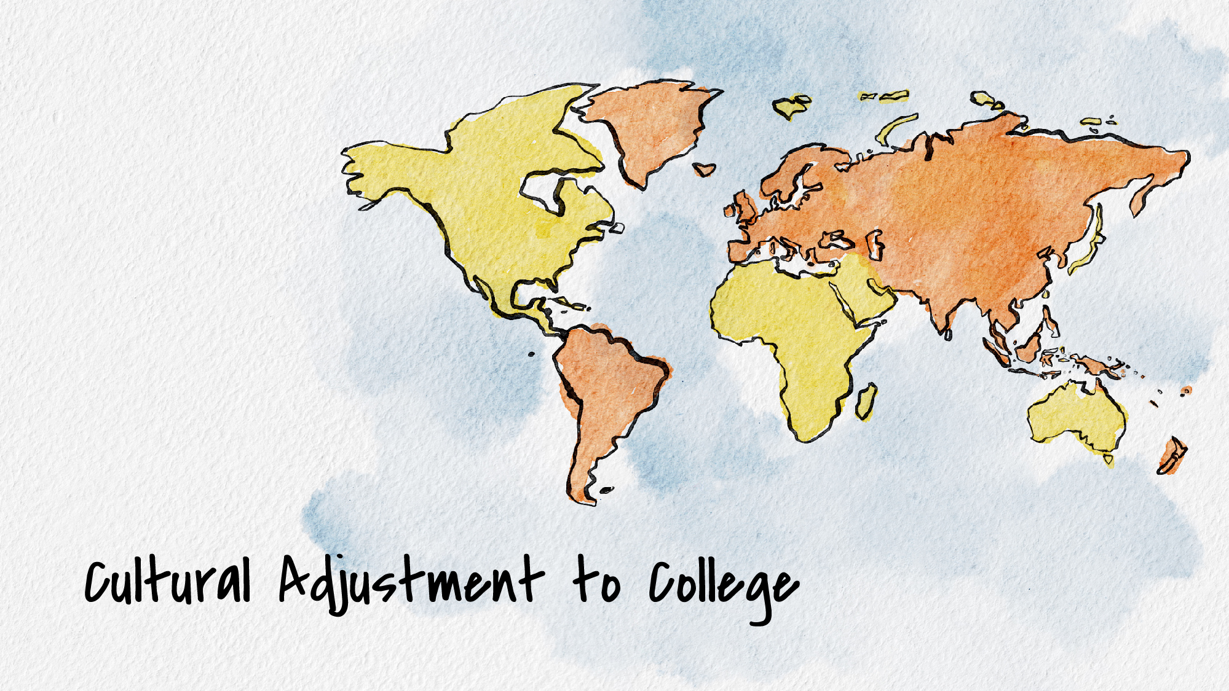

Cultural Adjustment to College
Navigating the Transition Successfully
UNL Counseling and Psychological Services (CAPS)

Slide 2

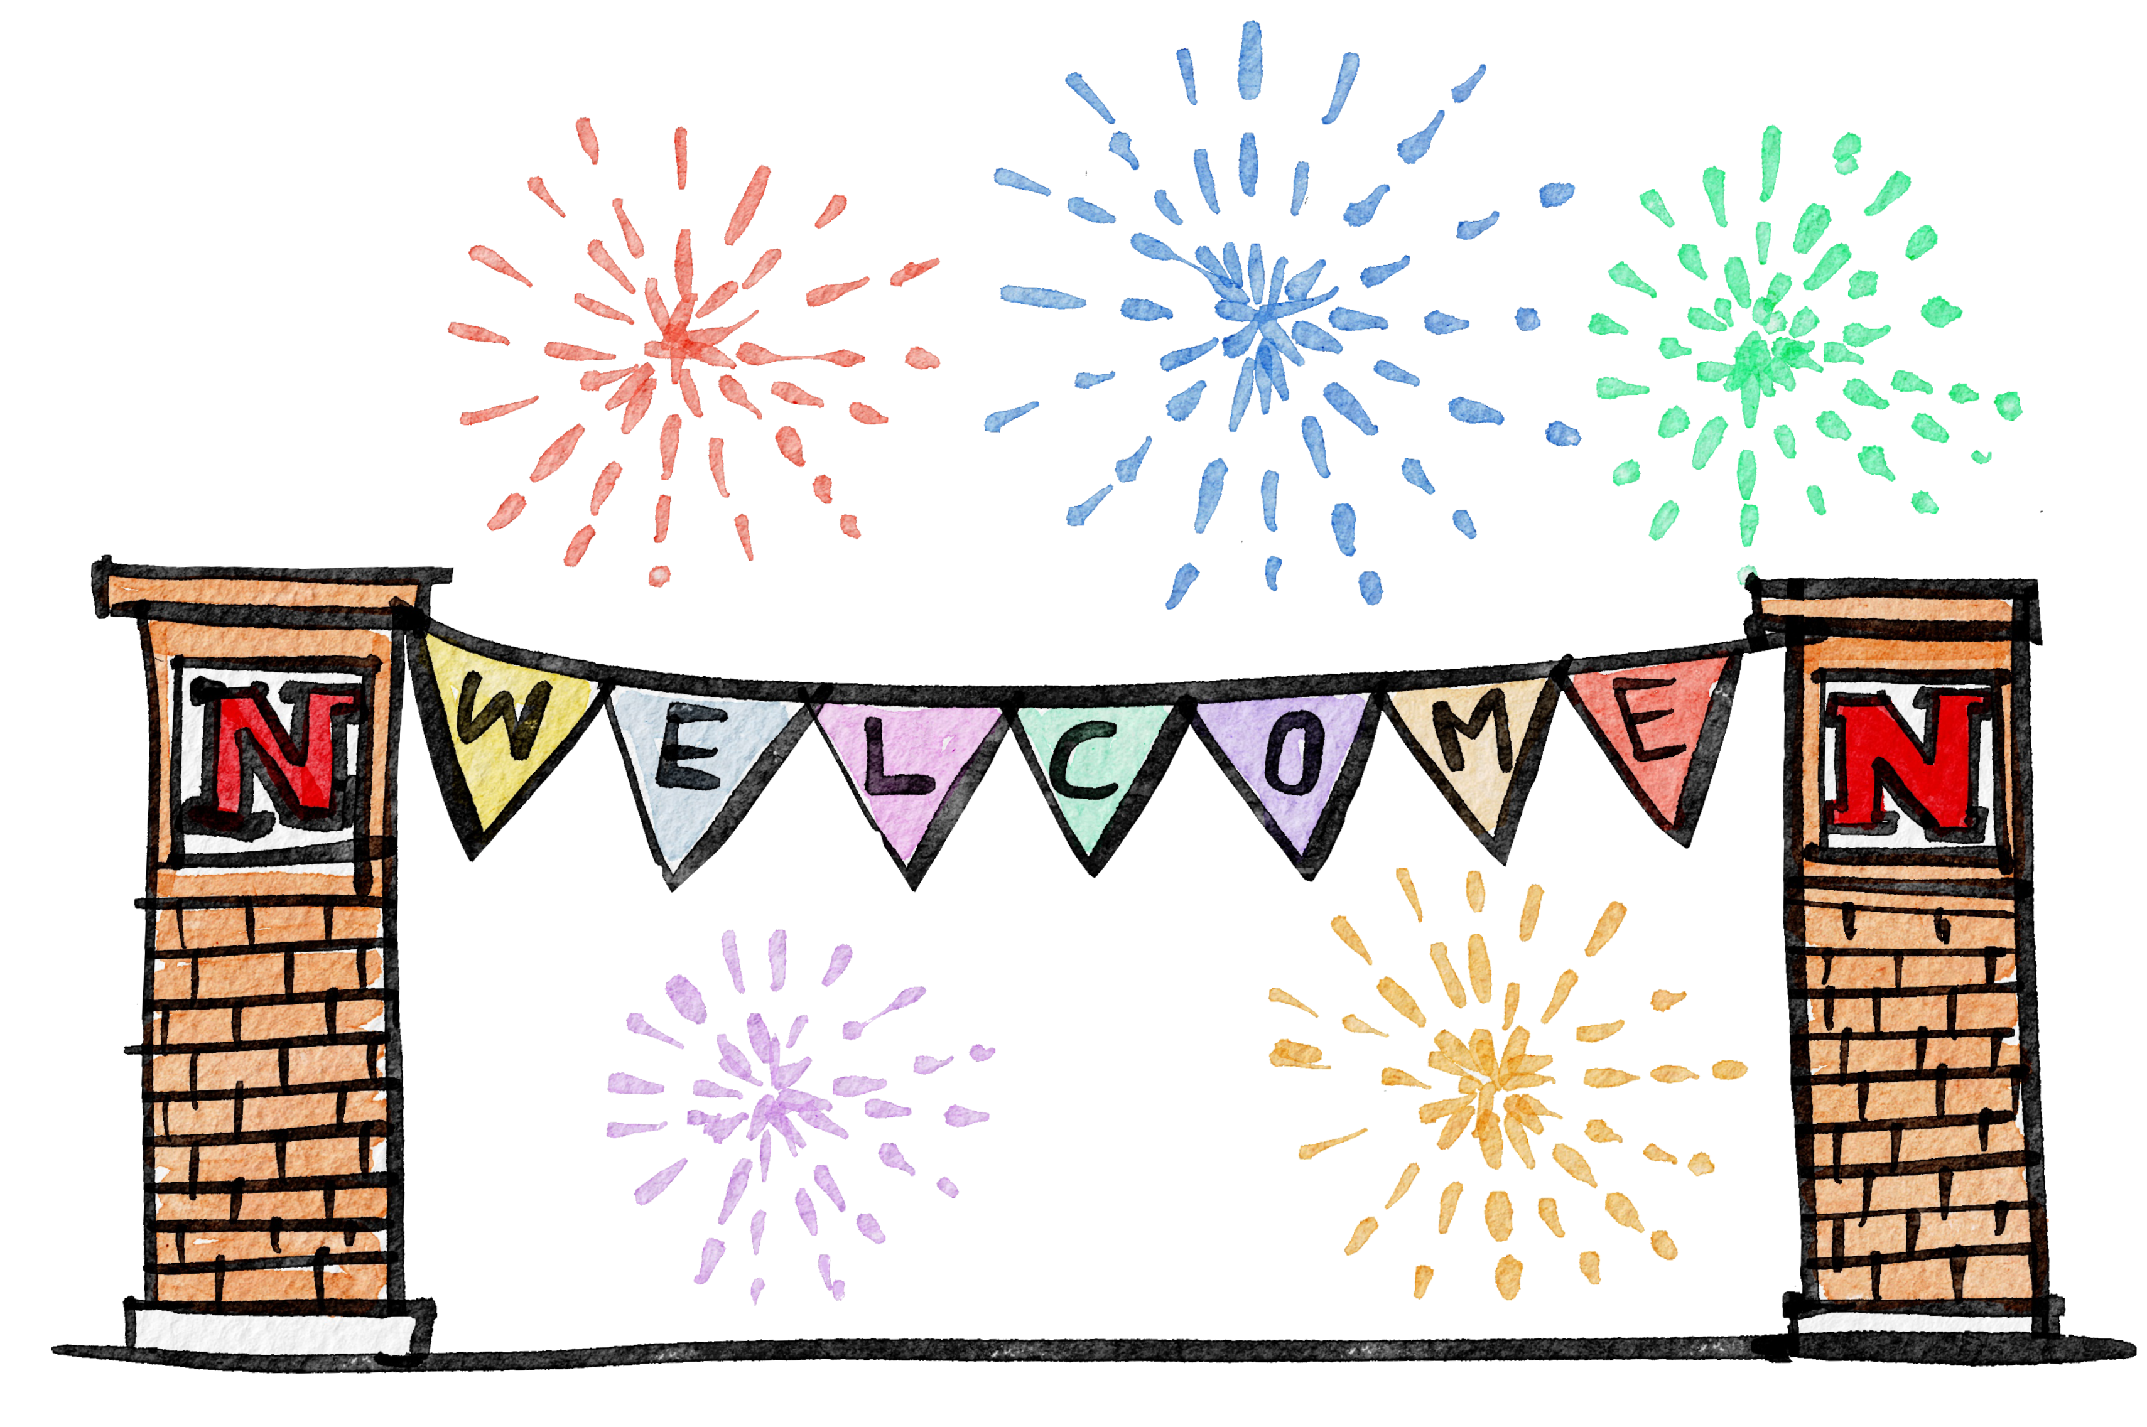
Welcome to UNL!
The purpose of this PowerPoint is to help international students adjust culturally to life at UNL.

Slide 3
Challenges Faced by International Students
Language Barrier
Homesickness
Cultural Differences
Academic Pressures
CAPS is here to emphasize that these challenges are normal and manageable with the proper support and resources.

Slide 4

Understanding Cultural Differences
Communication Styles
Classroom Etiquette
Social Norms
(Tips for navigating these differences effectively)

Slide 5
Example and Tips for Navigating Cultural Differences
Example 1: Discussing academic disagreements respectfully in class without offending others’ viewpoints.
Tip: Use phrases like "I understand your perspective, but have you considered this aspect?" to engage in constructive dialogue.
Example 2: Participating in group projects with students from diverse backgrounds.
Tip: Foster open communication, listen actively, and appreciate different contributions to the project.

Slide 6

Cultural Sensitivity and Respect
UNL emphasizes the importance of cultural sensitivity, respect, and curiosity in navigating cultural differences.
Students are encouraged to ask questions, seek understanding, and approach interactions with an open mind and willingness to learn.

Slide 7
Support Services at UNL
International Student and Scholar Office (ISSO),
Offers virtual advising, you can get a travel signature, and they have events
Counseling services,
Academic advisors,
Cultural clubs
We encourage students to utilize these resources for guidance and assistance

Slide 8
Building a Support Network
Transitioning to college can be challenging, especially in a new country. Having a support network is crucial for your well-being and success at UNL.
Studies show that students with strong support systems have higher academic performance, lower stress levels, and a more positive college experience.
Students are encouraged to reach out and connect with fellow international students as well as domestic students. Peer support can be incredibly valuable during the adjustment period.
Joining study groups, attending social events, and participating in group activities to meet new people and form friendships.

Slide 9

Coping Strategies for Cultural Adjustment
Maintaining a healthy lifestyle
E.g., eat a balanced meal 3 times a day, get adequate sleep (about 7-8 hours per night)
Staying connected with family and friends
E.g., call friends and family back home to check in, write letters/send postcards back home
Exploring new hobbies
E.g., look at campus Recognized Student Organizations (RSOs) at https://unl.campuslabs.com/engage/organizations
Seeking help when needed
E.g., check in with your advisor throughout your college experience, ask questions via email or in office hours with your professor and/or teaching assistant (TA)

Slide 10
Academic Success Tips
Time Management
Effective study habits
Campus resources
Communicating with professors
Academic success campus resources can be found at https://success.unl.edu/resources/navigating-campus-resources/

Slide 11
Counseling and Psychological Services (CAPS)
2nd floor of the University Health Center (located at 550 N 19th St) in suite 223
402-472-7450
Short-term individual counseling and partner counseling and unlimited group counseling sessions

Slide 12

Connect with CAPS
Call to schedule an appointment at 402-472-7450
Follow CAPS @unlcaps on Instagram

