Slide 1
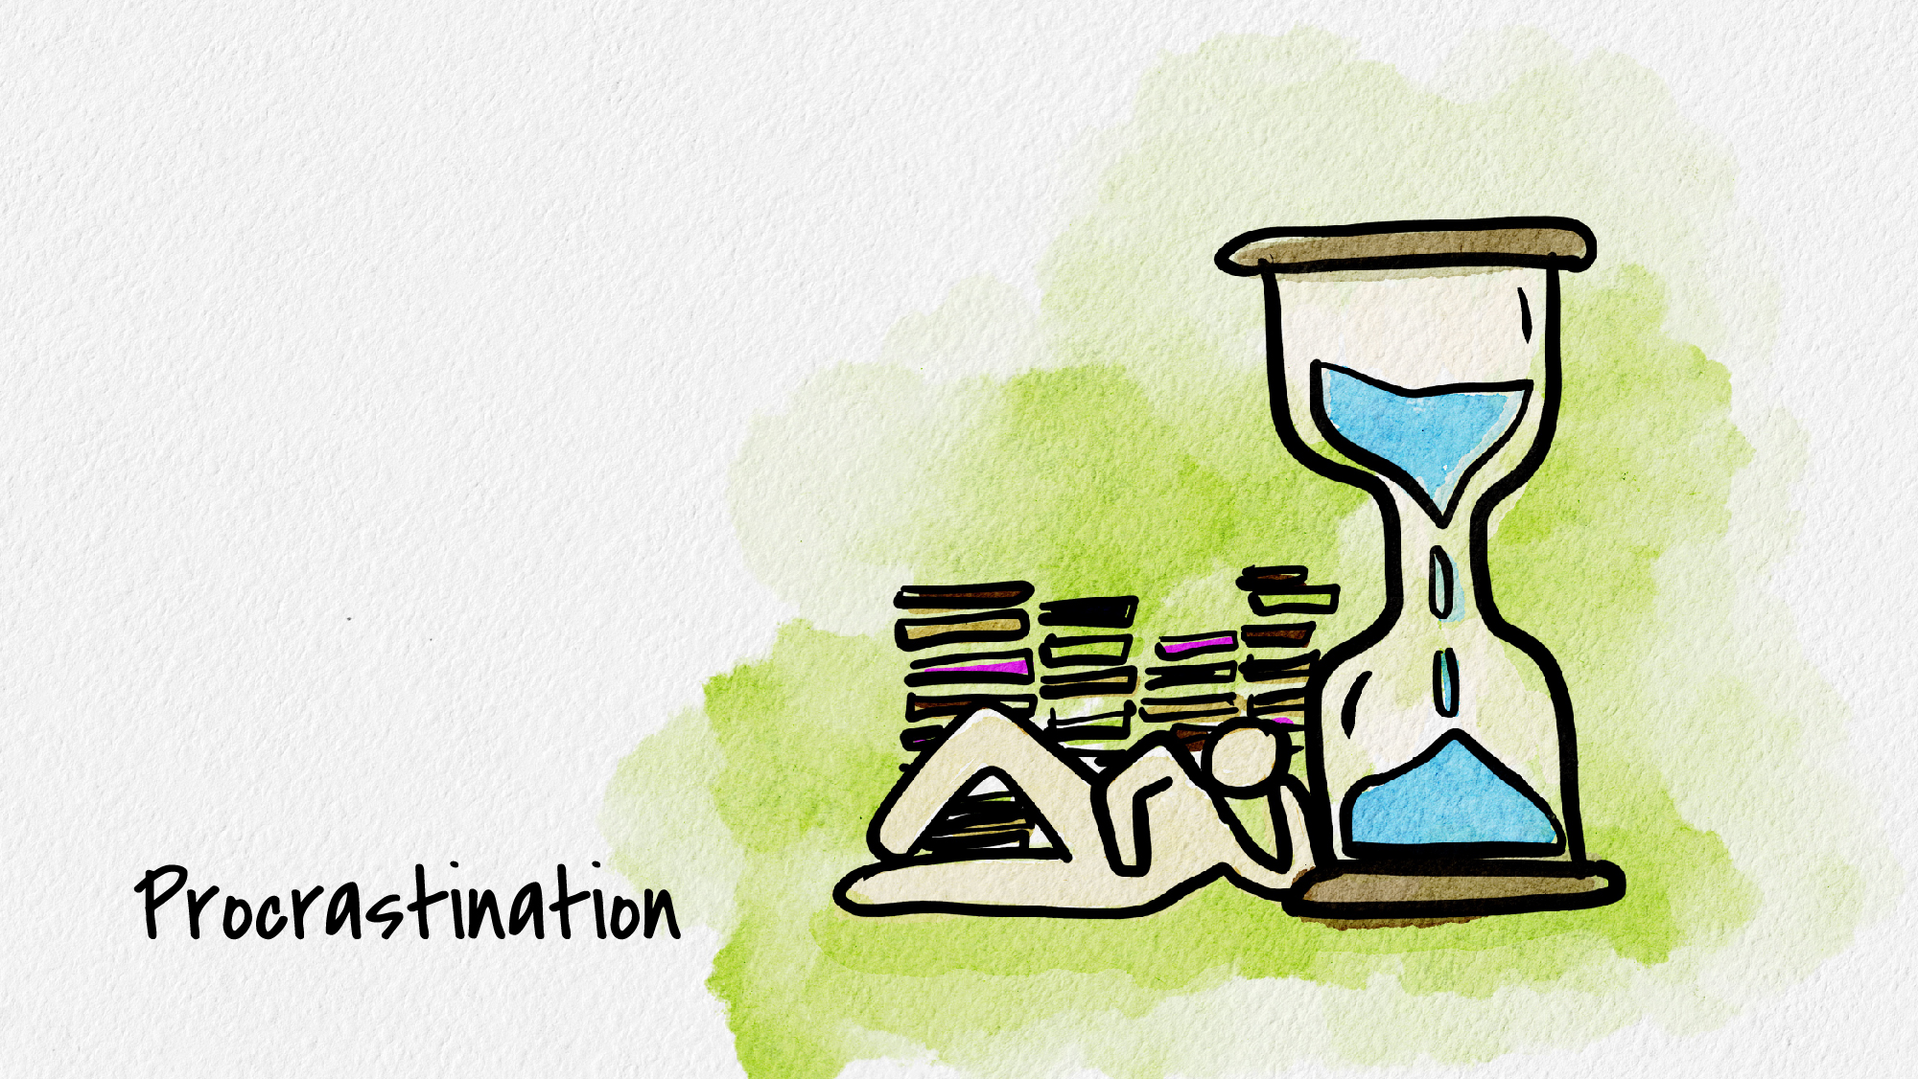


Slide 2
Which of the following situations sound familiar?
You have a test on Thursday, but you plot out how much time you will need to study for it… all night on Wednesday night.
A paper was assigned at the beginning of the semester, and your outline is due… tomorrow.
You need to start research to support your thesis, but it is such a huge task, you keep finding other things to do.
You’ve thought… “I’m taking care of my procrastination issues… just you wait and see!”
You’re not alone.

Slide 3

Procrastinators unite!!!
Let’s face it, procrastinating may feel good in the moment. It allows us to continue scrolling social media, talking with friends, or binge-watching YouTube videos.
However, when that deadline looms in front of you…the panic sets in… and you frantically throw together the assignment… procrastination becomes a curse!
Well, keep watching for some helpful tips to combat this issue.

Slide 4

Tip #1: Break things down
One reason why we procrastinate is because we (subconsciously) find the work too overwhelming for us. It may help to break tasks down into more manageable parts, then focus on one of those parts at a time.
*And if you still procrastinate on the task after breaking it down, then break it down even further.

Slide 5
Tip #2: Change up your workspace
Different environments have different impact on our productivity.
Would organizing your workspace help you?
Look at your work area and your room… Does it make you want to work or run away screaming? Think about creating a work-space away from distractions.
Is your roommate a talker? If so, consider going to the library to study.
IMPORTANT!!!! Reward your study time with some earned relaxation. (2 hours study = 1 episode on Netflix)

Slide 6

Tip #3: Create a timeline with specific deadlines for yourself
Break down your assignment/studying into smaller tasks. then create an overall timeline with specific deadlines for each small task. This way, you know you need to finish each task by a certain date.
Your timelines should be solid, too – i.e. if you don’t finish this by the assigned date, it’s going to jeopardize your remaining timelines. That way it creates the urgency to act.

Slide 7
Tip #4: Get rid of your pit-stops
If you are procrastinating a little too much, maybe that’s because there are too many distractions around you.
Put your phone away for a while. Disable the automatic notification option in your text messages. Close out of distracting sites on your computer. Do not turn on Netflix until you have completed your tasks for the day.

Slide 8
Tip #5: Think about why you’re avoiding
Consider the reasons why you’re putting off the things you need to do:
  Does it seem like you are comparing yourself to others?
  Are you doubting your own abilities or fearful that you might fail?
  Do you struggle if things aren’t done “perfectly”?
  Are you feeling bored with what you are doing?
Sometimes once we understand the reason behind our procrastination, we can work to change it!

Slide 9

Tip #6: Consider trying helpful thinking
Typical “excuse”
I’m really tired, I’ll start later.
I’ll miss out on the fun happening.
I have plenty of time to work on this.
I have other things I’d rather do.
Justification
I can do it when I get up in the morning.
I can just wait to study until nothing much is happening.
I don’t have to start it until later.
I’ll do it once those things are finished.
Helpful thinking
But I can still make a small start right now…
If I get some of it done, I can reward myself with other fun later.
Better to get on top of it now than leave it to the last minute.
But they are not more important than my assignment.

Slide 10
Tip #7: Don’t wait until the perfect time
When you recognize that you’re procrastinating or are having the urge to procrastinate, handle it in a non-judgmental and non-blaming way.
Don’t beat yourself up for it, but instead recognize that procrastination has arrived and that you’re going to make a choice to do things differently.

Slide 11
Tip #8: Push yourself
At the end of the day, it all boils down to taking action.
You can do all the strategizing, planning and hypothesizing, but if you don’t take some action, nothing will happen.
Push through your reluctance and do it!
Success is yours….

Slide 12
Thank you!
If you’d like to connect with Counseling and Psychological Services (CAPS), we’re here for you.
Individual Counseling
Call to schedule an appointment: (402) 472-7450
Let’s Talk
Chat informally with a professional from CAPS. Learn more at https://caps.unl.edu/lets-talk
Virtual sessions are available by appointment.
In-person sessions available through TRIO or Military & Veteran Success Center.
Counseling and Psychological Services | Located in the University Health Center, Level Two

