Slide 1
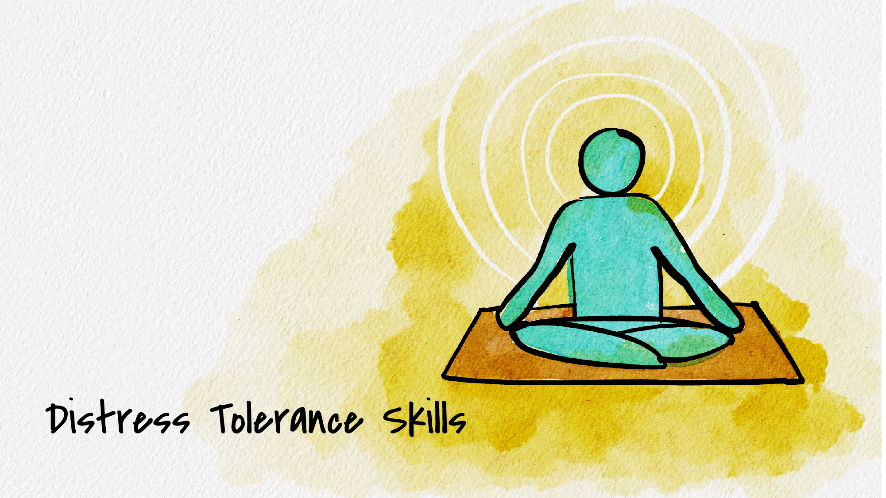


Slide 2
What is distress tolerance?
Coping Skills
  Self-Soothing
  Distraction
  Grounding
  Etc.

Slide 3
Goals of distress tolerance
Survive difficult/crisis situations without making them worse
Accept pain/difficulty of a situation and avoid being “stuck”
Feel less jerked around by your emotions to feel more in control

Slide 4
When to use distress tolerance skills
Situations that are highly stressful
Short term situations
Situations that create intense pressure to resolve the situation now
Times when you want to act on your emotions but that will only make things worse
When emotions threaten to overwhelm you, but you need to accomplish goals
When stress levels are high, but problems can’t be solved immediately

Slide 5
When NOT to use distress tolerance skills
For everyday problems
For solving all your problems
For making life worth living

Slide 6
Distress Tolerance Skills: Physiological
Cool water on your face
  Enacts dive reflex
  Hold breath for 30 seconds while putting cool water on your face, especially your temples
Exercise
  Helps naturally rid brain of stress hormones by doing what your body is preparing to do
  Research shows 20 minutes at 70% of max heartrate
Deep Breathing
  Engages parasympathetic nervous system
  Make sure outbreath is longer that inbreath (5 seconds in, 7 seconds out)
  Can add progressive muscle relaxation to deep breathing to increase benefits
Notes:
Distress tolerance skills: Physiological
Cool water on your face
Enacts dive reflex which slows down breath and heart rate
Hold your breath for 30 seconds while putting cool water on your face, especially your temples
Exercise
Helps to naturally rid your brain of stress hormones by doing what your body is preparing for (fight/flight)
Research shows 20 minutes at 70% of your max heartrate
Deep breathing
Deep breathing engages parasympathetic nervous system and slows heartrate
Make sure outbreath is longer than inbreath (5 seconds in, 7 seconds out)
Can add progressive muscle relaxation to deep breathing to increase benefits (slowly tense and relax different muscle groups)

Slide 7
Distress Tolerance Skills: Distracting
Activities
Watch TV, go for a walk, spend time with friends, play a game, have a meal, listen to music, go for a drive, etc.
Focus on others
Volunteer, help a friend, donate items to charity, do something nice for someone
Create a “happy place” in your mind
Favorite vacation spot, where you go to relax, beach, lake, mountains
Put things into perspective
Compare how you are feeling now to a time you felt worse, think about others who are coping the same or worse than you, think of others who are less fortunate
Thoughts
Count backward by 7’s, repeat words to a song in you mind, spell words backward, put things in chronological or alphabetical order
Notes:
Distress tolerance skills: Distracting
Activities
Watch TV, go for a walk, spend time with friends, play a game, clean your room, have a meal, listen to music, do a puzzle, go for a drive
Focus on others
Volunteer, help a friend, donate items to charity, do something nice for someone
Put things into perspective
Compare how you are feeling now to a time when you felt worse, think about others who are coping the same or worse than you, think about others who are less fortunate
Thoughts
Count backward by 7’s, repeat words to a song in your mind, spell words backward, put things in chronological or alphabetical order, recite things you have memorized
Create a happy place in your mind
Favorite vacation spot, where you go to relax, beach, lake, mountains

Slide 8
Distress Tolerance Skills: Grounding
Squeeze a rubber ball very hard
Listen to loud music
Hold ice in you hand or mouth
Take a hot or cold shower
5 things you can see, 4 things you can feel, 3 things you can hear, 2 things you can smell, 1 thing you can taste

Slide 9
Distress Tolerance Skills: Self-Soothing
Sight
Look at the stars, look at pleasing art, look at old photos, watch nature
Sound
Listen to soothing music, listen to nature, ASMR videos
Smell
Use your favorite body lotion or shampoo, light a scented candle, open a package of coffee
Taste
Eat your favorite food, drink tea or coffee, chew gum, hard candy, mints
Touch
Pet an animal, sit in the sun, put on lotion, wear your comfiest clothes, get a massage, take a bath, snuggle up in a blanket

Slide 10
Distress Tolerance Skills: Radical Acceptance
What is radical acceptance?
  Complete and total acceptance of reality as it is, facts of the situation, and limitations
  Letting go of stubbornness, hurt, the way things “should” be.
Why use it?
  Rejecting reality does not change reality.
  Changing reality requires accepting what is.
  Refusing to accept reality can keep you stuck in painful emotions.
  Accepting reality leads to problem solving.
Notes:
Distress tolerance skills: radical acceptance
Radical acceptance is complete and total acceptance of reality as it is, the facts of the situation, and limitations
Letting go of stubbornness, hurt, the way things “should” be
Why use radical acceptance
Rejecting reality does not change reality
Changing reality requires accepting what is
Refusing to accept reality can keep you stuck in painful emotions
Accepting reality leads to problem solving

Slide 11
How to accept reality
Take deep breaths
Make choice to accept reality
Use positive self-talk
Body language
Repeat
Ask “what’s the threat?”
Notes:
How to accept reality
First, take some deep breaths. Calm yourself down so you can see the situation clearly
Make the choice to accept reality and let go of anger, frustration, or bitterness
Use positive self-talk to remind yourself of reality and tell yourself that things will be okay
Make sure your body language is open and accepting, without tension or frustrated expression
Repeat steps 1-4 as often as you need to in order to continue to accept reality
If you notice you are feeling unable to accept, ask yourself “what’s the threat?” Challenge this belief.

Slide 12
Thank you!
If you’d like to connect with Counseling and Psychological Services (CAPS), we’re here for you.
Individual Counseling
Call to schedule an appointment: (402) 472-7450
Let’s Talk
Chat informally with a professional from CAPS. Learn more at https://caps.unl.edu/lets-talk
Virtual sessions are available by appointment.
In-person sessions available through TRIO or Military & Veteran Success Center.
Counseling and Psychological Services | Located in the University Health Center, Level Two

