Slide 2
Transition to college
Normative developmental changes and challenges across the following areas:
Academics
Social
Cultural
Personal Wellness
Stress management

Slide 3
Tips for transition
Settle into your environment: add comforts from home, explore campus
Meet new people: go to RA/floor events, dining hall, classes, join RSOs, go to campus-sponsored events/speakers
Get organized: find what works for you (calendar, planner, etc.)
Identify and use support resources: CAST, BRRWB, OASIS, CAPS, University Health Center
Develop a routine and healthy habits: sleep, nourishment, exercise; self-care, re-examine your beliefs and values
Notes:
What are some thing that have gone well for your during your transition to UNL? Where have you seen the most personal growth? In what areas are you struggling?

Slide 4
Academics
What is going well academically? What challenges have you faced or are you worried about?
Ex: managing due dates, class attendance, increased workload or pace from high school, larger class sizes, performance on initial quizzes/exams
What can you do to manage these challenges: attend class, read/review throughout the semester, study in advance, work ahead on large projects, Time management: sample schedule - Weekly time management schedule .docx (sharepoint.com)
Academic resources: Center for Academic Success and Transition, Big Red Resilience and Wellbeing, Office of Academic Success and Intercultural Services, attend office hours, create study groups

Slide 5
Social adjustment & transitions
Coping with homesickness: It is normal!
Relationships: assess pre-existing relationships, strategies for meeting new people
Adjusting to life with a roommate

Slide 6
Cultural adjustment
In what ways are UNL and the City of Lincoln similar to and different from your home environment?
Potential challenges: Homesickness, identity and value confusion, uncertainty/fear/anxiety, sadness or low mood, feeling lonely or isolated
You are not alone: Stages of cultural adjustment – the honeymoon, initial culture shock, recovery and adjustment, isolation, assimilation and adaptation

Slide 7
Personal wellness & stress management
Stress is normal, necessary and unavoidable
Becomes a problem when it causes significant distress and impairs ability to function
Stress responses: cognitive, emotional, physiological, behavioral
Foundations of good physical, mental and emotional health: adequate sleep; healthy eating habits; daily exercise; abstain from or limit caffeine, alcohol or drug use
Self-care: physical, emotional, professional, personal, spiritual, psychological, relational
Notes:
What contributes to your stress? How do you notice when you’re feeling “stressed out”? What are your stress warning signs?, what behaviors are important for you specifically to remember to do (or to avoid) when feeling stressed?, how do you practice self-care? What are barriers and how might you overcome/address them?

Slide 8
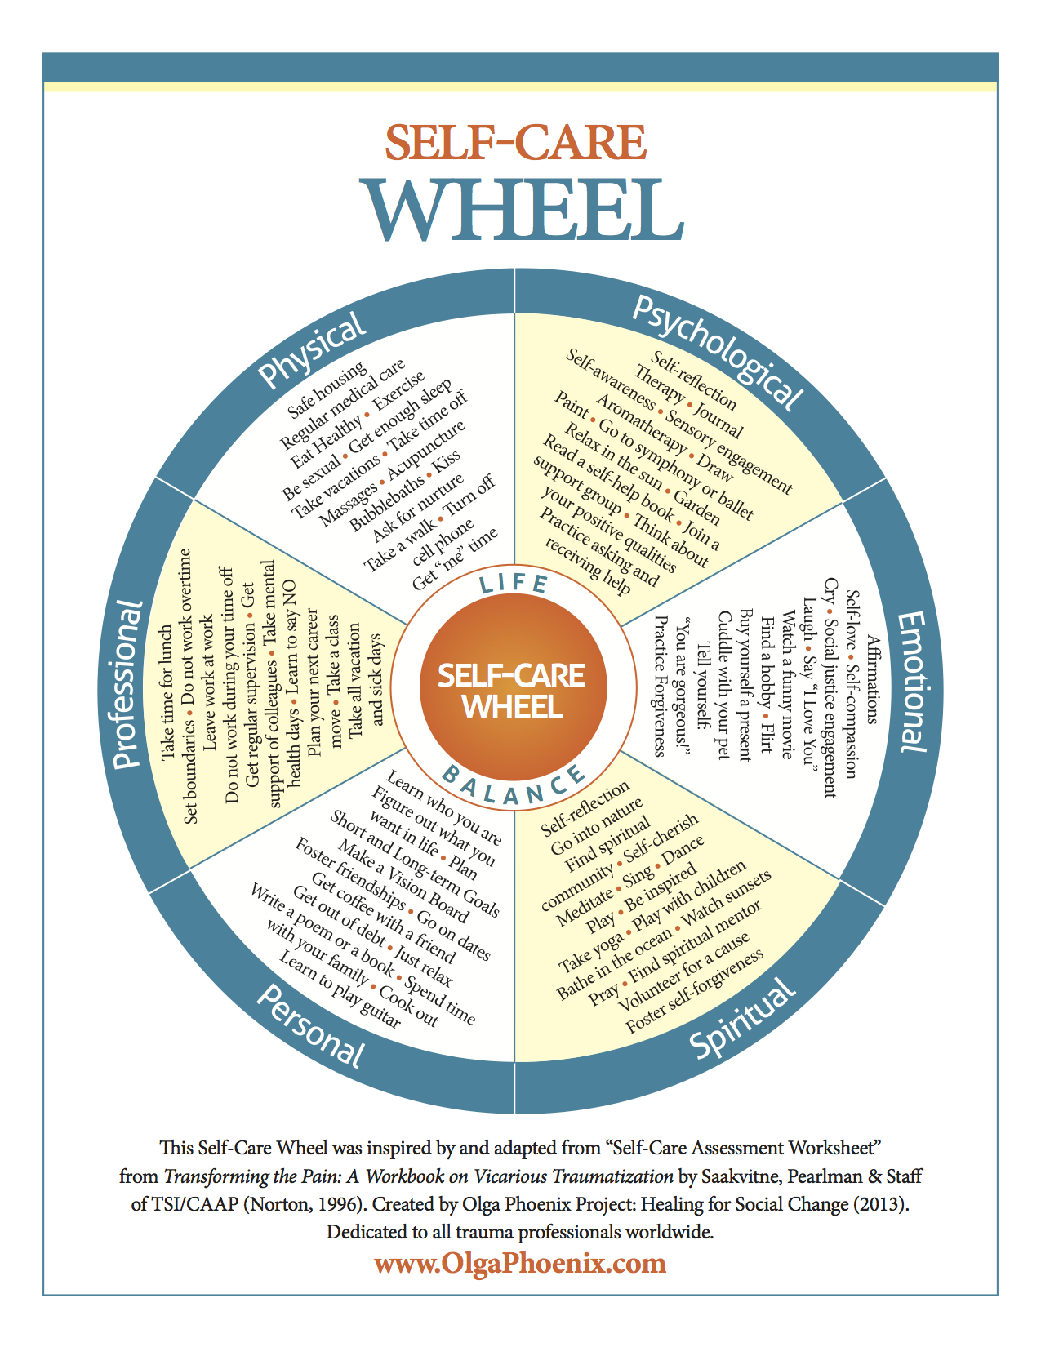

Slide 9
Transition to college - reflections
What are you most proud of in your college transition journey so far?
Whare are some things you want to continue to work on?
What resources do you plan to use to promote continued success?

Slide 10
Thank you!
If you’d like to connect with Counseling and Psychological Services (CAPS), we’re here for you.
Individual Counseling Call to schedule an appointment: (402) 472-7450
Let’s Talk Chat informally with a professional from CAPS. Learn more at https://caps.unl.edu/lets-talk
Virtual sessions are available by appointment.
In-person sessions available through TRIO or Military & Veteran Success Center.
Counseling and Psychological Services | Located in the University Health Center, Level Two

