Slide 1
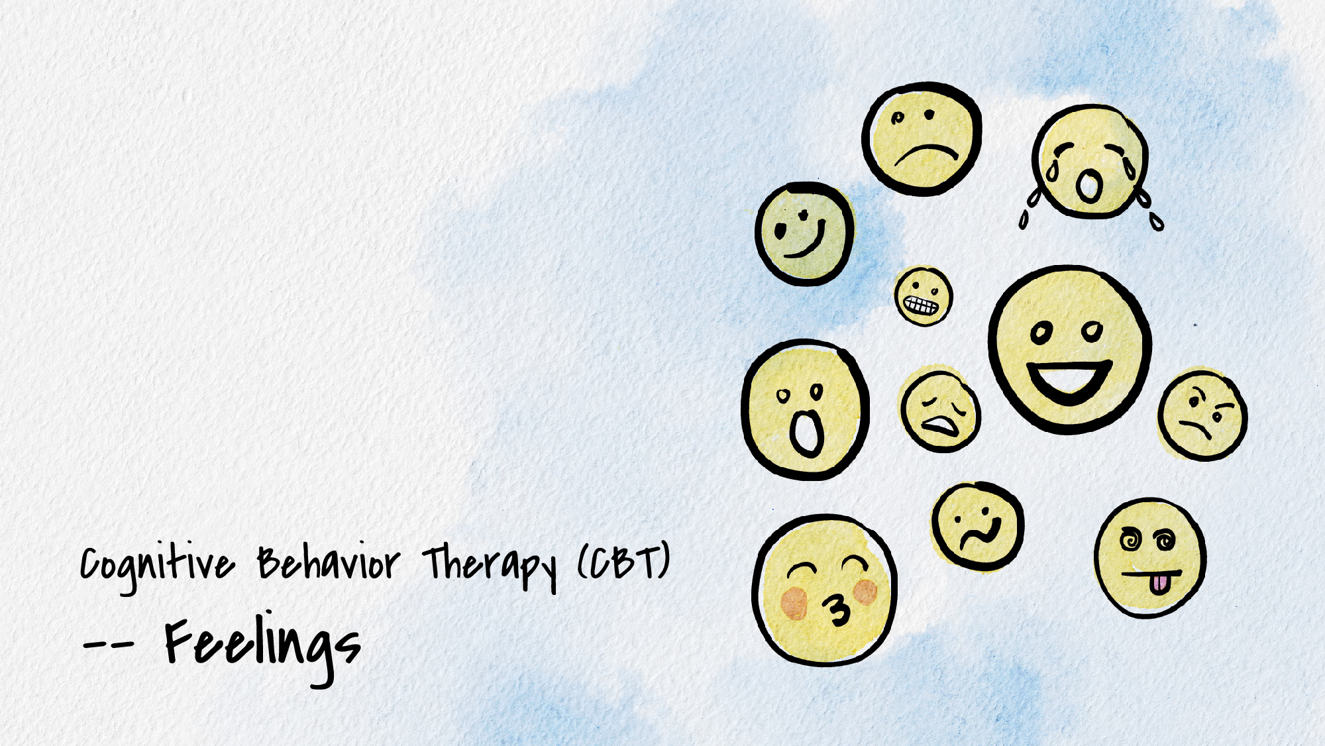


Slide 2
What is cognitive behavior therapy (CBT)?
A type of therapy that focuses on one’s behaviors, cognitions, and emotions and how that influences how we navigate and view ourselves, others, and the world.
Today you’ll learn skills to regulate emotions from a cognitive behavioral approach.

Slide 3
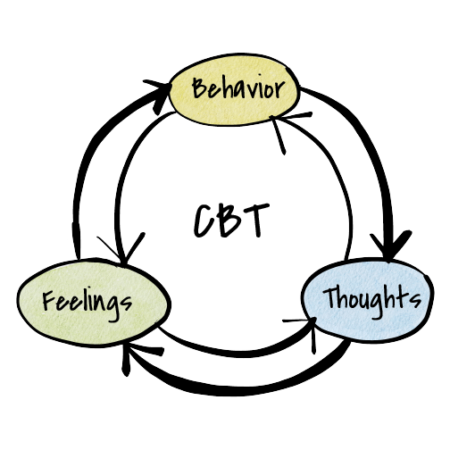
Cognitive behavior cycle
What we THINK affects how we ACT and FEEL
How we FEEL affects what we THINK and DO
What we DO affects how we THINK and FEEL

Slide 4
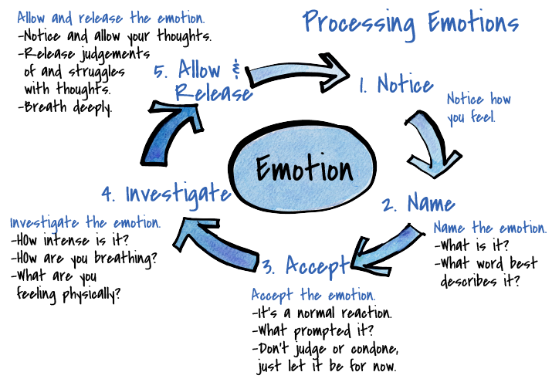

Slide 5
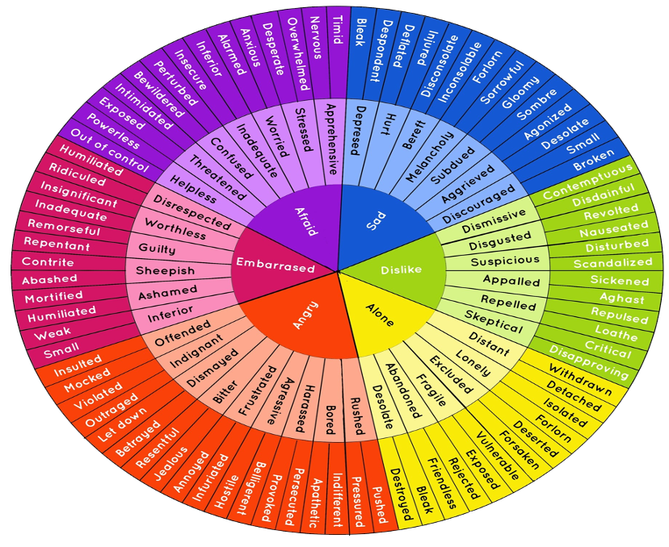
Steps 1 & 2
Notice and name the emotion
Use these charts to find a word that best describes your emotion.

Slide 6
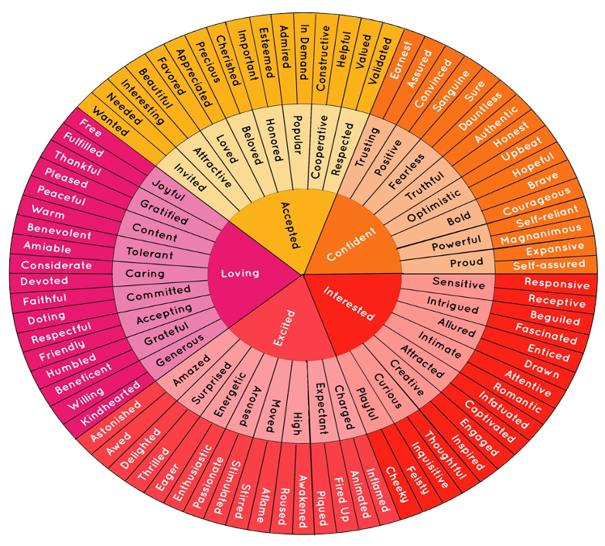
Steps 1 & 2
Notice and name the emotion
Use these charts to find a word that best describes your emotion.

Slide 7
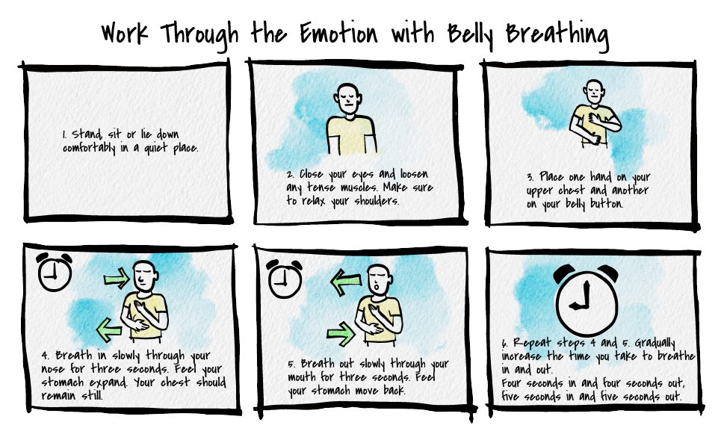

Slide 8
Thank you!
If you’d like to connect with Counseling and Psychological Services (CAPS), we’re here for you.
Individual Counseling
Call to schedule an appointment: (402) 472-7450
Let’s Talk
Chat informally with a professional from CAPS. Learn more at https://caps.unl.edu/lets-talk
Virtual sessions are available by appointment.
In-person sessions available through TRIO or Military & Veteran Success Center.
Counseling and Psychological Services | Located in the University Health Center, Level Two

