Slide 1
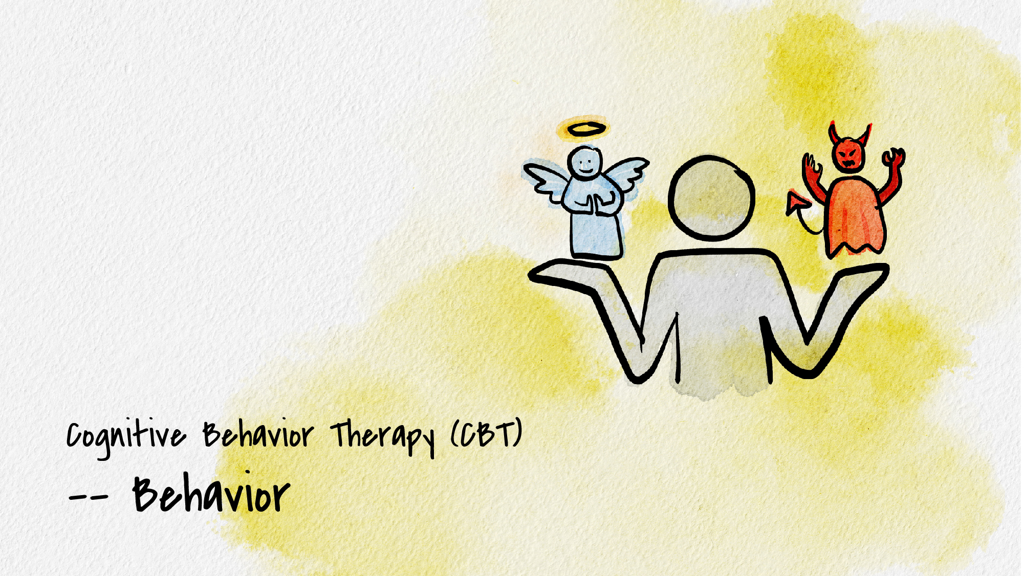


Slide 2
What is cognitive behavior therapy (CBT)?
A type of therapy that focuses on one’s behaviors, cognitions, and emotions and how that influences how we navigate and view ourselves, others, and the world.
Today you’ll learn skills to manage unwanted thoughts from a cognitive behavioral approach.

Slide 3
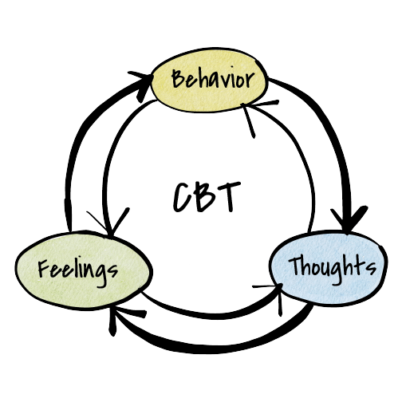
Cognitive behavior cycle
What we THINK affects how we ACT and FEEL
How we FEEL affects what we THINK and DO
What we DO affects how we THINK and FEEL

Slide 4
What is behavioral activation?
The process of breaking down large or complex tasks into smaller more manageable tasks to increase productivity.
Essential concept: Action precedes motivation
“I can choose to do this even if I don’t want to.”

Slide 5
Positive activities for behavioral activation
Create a list of activities that you find rewarding. Rate each activity in two categories:
  How easy will the activity will be for you to complete?
  How rewarding is this activity?
Use a 1-10 scale with 10 being very easy or rewarding and 1 being difficult or not at all rewarding.
Notes:
Sometimes it is helpful to start by making a list of positive activities or a list of responsibilities that you need to get done.
If one of your responsibilities is a big research project, break it down into sections and list each section of the project as its own “activity”.

Slide 6
Weekly schedule for behavioral activation
Create a list of activities that will lead to positive experiences in your day. If you’re feeling depressed or unmotivated, it might be difficult to complete large or complex tasks. If this is the case, start with simple goals to work your way up to more challenging activities.
DAY | MORNING | AFTERNOON | EVENING
Example | Wake by 8 a.m. Eat a full breakfast | Go for a 15-minute walk | Call a friend Practice guitar
Add your own
Notes:
Here is a different way to utilize behavioral activation… Plan out small tasks to accomplish throughout the day.
REMEMBER… Action precedes motivation, motivation comes from the productivity you have created.

Slide 7
Thank you!
If you’d like to connect with Counseling and Psychological Services (CAPS), we’re here for you.
Individual Counseling
Call to schedule an appointment: (402) 472-7450
Let’s Talk
Chat informally with a professional from CAPS. Learn more at https://caps.unl.edu/lets-talk
Virtual sessions are available by appointment.
In-person sessions available through TRIO or Military & Veteran Success Center.
Counseling and Psychological Services | Located in the University Health Center, Level Two

